Slide 1
CSSE3113 – Introduction to Software Engineering
Software Process Models

Slide 2
Software Development
Construction
Some of the major construction activities are listed below.
Requirement Gathering
Design Development
Coding
Testing
Management
Some of the major management activities are listed below.
Project Planning and Management
Configuration Management
Software Quality Assurance
Installation and Training

Slide 3
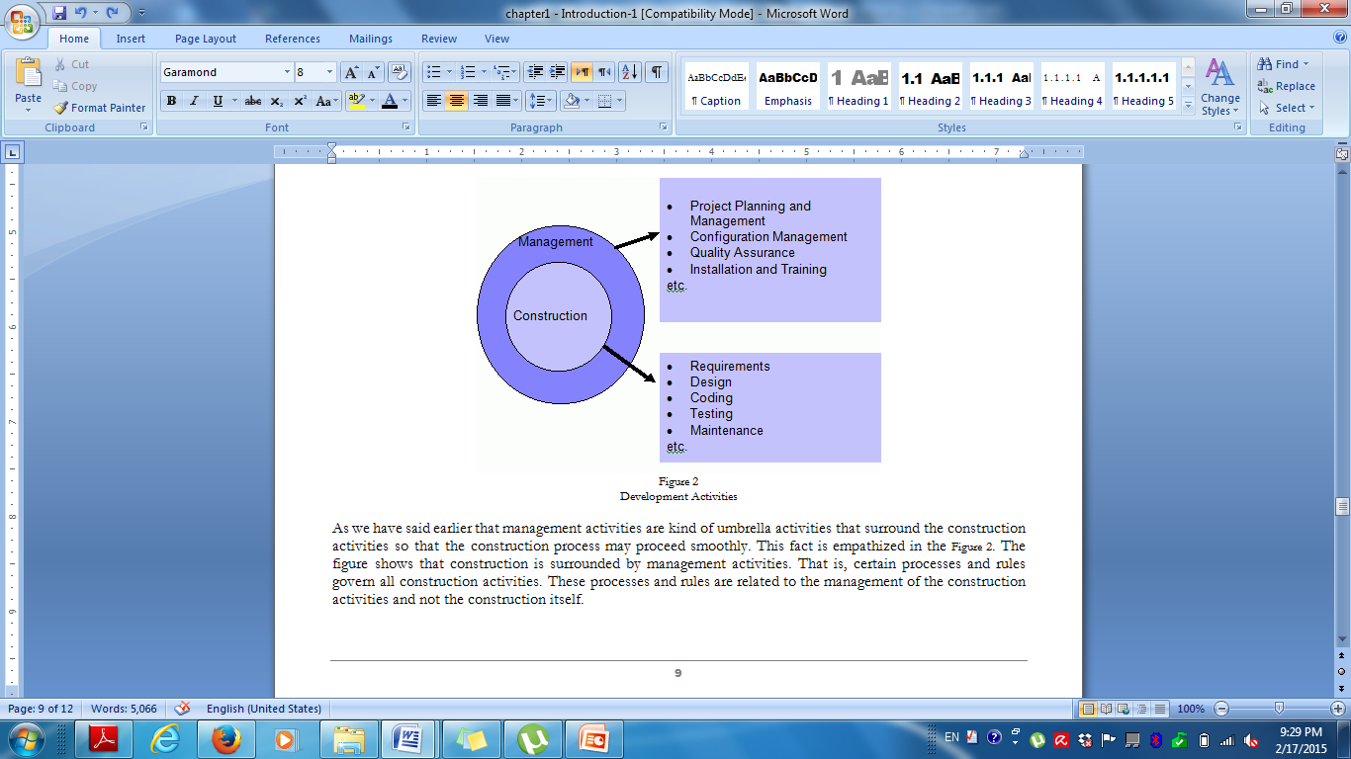
Figure 1: Development Activities

Slide 4
Ad hoc Software Development
Developing software without planning for each phase, and without specifying tasks, deliverables, or time constraints.
Relies entirely on the skills and experience of the individuals performing the work.
The software process may change as work progresses.

Slide 5
Case Study : SaudiTech
What could go wrong in a software development project?
SaudiTech is a software company. It has a team of 25 programmers. Ali has recently established a dental clinic in Riyadh and asked SaudiTech to develop a management system for his dental clinic.
Ali’s request was to develop a system to electronically manage patient records and perform administrative functions similar to ‘what is being used in other clinics’ but within a budget of 500 Saudi riyals and delivered within 3 months.
SaudiTech adopts an ad hoc approach (Developing software without planning for each phase, and without specifying tasks, deliverables, or time constraints) to software development and has not worked on large scale projects before.
What problems do you anticipate in this project?

Slide 6
How can we overcome problems with ad hoc software development?
Problems:
Difficult to distinguish between tasks → important tasks may be ignored.
Inconsistent schedules, budgets, functionality and product quality.
Delayed problem discovery → more costly to fix.
Software Process Models provide guidelines to organize how software process activities should be performed and in what order.
Solution? Software Process Model

Slide 7
The Software Process
A structured set of activities required to develop a software system.
Many different software processes but all involve:
Specification – defining what the system should do
Design and implementation – defining the organization of the system and implementing the system;
Validation – checking that it does what the customer wants;
Evolution – changing the system in response to changing customer needs.
A software process model is an abstract representation of a process. It presents a description of a process from some particular perspective.

Slide 8
Software Process Descriptions
When we describe and discuss processes, we usually talk about the activities in these processes such as specifying a data model, designing a user interface, etc. and the ordering of these activities.
Process descriptions may also include:
Products, which are the outcomes of a process activity;
Roles, which reflect the responsibilities of the people involved in the process;
Pre- and post-conditions, which are statements that are true before and after a process activity has been enacted or a product produced.

Slide 9
Plan-driven and Agile Processes
Plan-driven processes are processes where all of the process activities are planned in advance and progress is measured against this plan.
Plan drives everything!
In Agile Processes planning is incremental and it is easier to change the process to reflect changing customer requirements.
In practice, most practical processes include elements of both plan-driven and agile.
There are no right or wrong software processes.

Slide 10
Software Process/SDLC Models
Software Process model:
Abstract representation of a software process
Each Process model represents a process from different perspective
Following are the most important and popular SDLC models followed in the industry:
Waterfall model.
V Model
Evolutionary development.
Component-Based development model (CBSE).
Process iteration(incremental and spiral Models)
The other related methodologies are Agile and RAD Model – Rapid Application Development

Slide 11
Waterfall Model
First published model
Because of the cascade from one phase to another, this model is known as ‘Waterfall Model’.
It is also referred to as linear-sequential life cycle model.
Each phase must be completed before the next phase can begin and there is no overlapping in the phases.

Slide 12
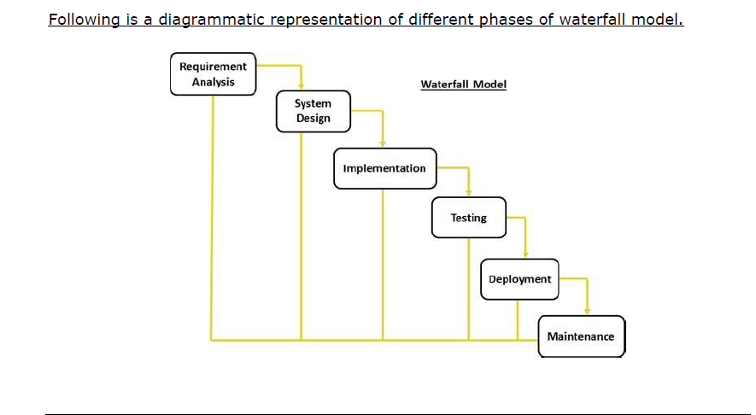
Waterfall Model

Slide 13
Waterfall Model
Applicability:
Requirements are very well understood, clear and fixed
Product definition is stable
Technology is understood

Slide 14
Waterfall Model
Advantages:
Documentation - at each phase
Phases are processed and completed one at a time.
Easy to arrange tasks.
Problems:
Inflexible partitioning of the project into distinct stages makes it difficult to respond to changing customer requirements.

Slide 15
V Model
A variation of the waterfall model
Development phases are presented in a V-shaped graph.
It is also known as Verification and Validation model.
For every single phase in the development cycle there is a directly associated testing phase.

Slide 16
Verification and Validation
Verification
Does the product meet system specifications?
Have you built the product right?
Validation
Does the product meet user expectations?
Have you built the right product?

Slide 17
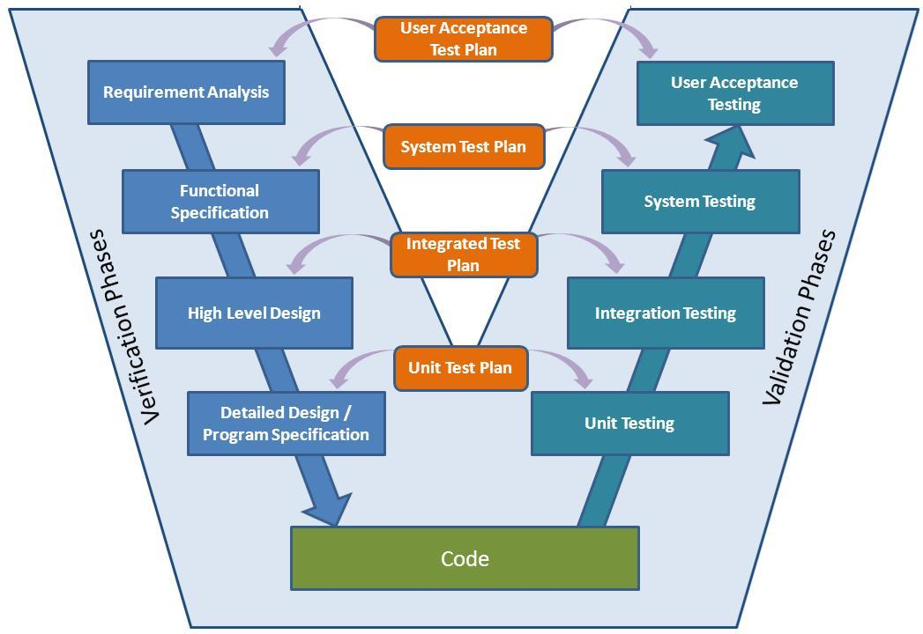
V Model

Slide 18
V Model
Advantages:
Testing activities like planning, test designing, happens well before coding.
Higher chances of success over the waterfall model.
Works well for projects where requirements are easily understood.
Problems:
Difficult to handle changes in requirements throughout the life cycle

Slide 19
V Model
Applicability:
The V-shaped model should be used for projects where requirements are clearly defined and fixed.
The V-Shaped model should be chosen when technical resources are available with needed technical expertise.
High confidence of customer is required for choosing the V-Shaped model approach.

Slide 20
Evolutionary Models
Evolutionary Development:
Includes the activities of specification, development and validation
Initial system is developed from abstract specification
Then refined with customer input to produce a system that satisfies the customer’ s needs.
Two types of evolutionary development
Exploratory
Prototyping

Slide 21
Evolutionary Models
Exploratory Model
Objective of the process is to work with customers to explore their requirements and deliver a final system.
The development starts with the parts of the system that are understood.
The system evolves by adding new features proposed by customer.
This model works best in situations where few, or none, of the system or product requirements are known in detail.

Slide 22
Exploratory Models
Specification
Initial Version
Outline Description
Intermediate Version
Development
Validation
Final
Version

Slide 23
Exploratory Model
Problems:
Lack of process visibility;
Systems are often poorly structured
Applicability:
For small or medium-size interactive systems
For parts of large systems (e.g. the user interface)

Slide 24
Evolutionary Models
Prototyping Model
When a customer defines a set of general objectives for a software but does not identify detailed I/O or processing requirements.
A prototype is built to understand the requirements.
By using this prototype, the client can get an “actual feel” of the system
The interactions with prototype can enable the client to better understand the requirements of the desired system
Prototyping is an attractive idea for complicated and large systems.

Slide 25
Evolutionary Models
Prototyping Model
Consists of 4 iterating phases:
Requirements gathering.
Design and build prototype.
Evaluate prototype with customer.
Refine requirements.

Slide 26
Prototype Model
1. Requirements gathering.
2. Design and build SW prototype.
3. Evaluate prototype with customer.
4. Refine requirements.
1 / 4
Listen to Customer
2
Build / Revise prototypes
3
Customer Test-Drives prototypes

Slide 27
Prototyping
Engineer
Product
Requirements
No
Quick
Design
Yes
Changes?
Build
Prototype
Refine
Prototype
Evaluate
Prototype
(Pressman, 1996)

Slide 28
Prototype Model
Advantages:
Users are actively involved in the development
Users get a better understanding of the system being developed.
Errors can be detected much earlier.
Quicker user feedback is available leading to better solutions.
Disadvantages:
Practically, this methodology may increase the complexity of the system as scope of the system may expand beyond original plans.

Slide 29
Prototype Model
Applicability:
Prototype model should be used when the desired system needs to have a lot of interaction with the end users.
Typically, online systems, web interfaces have a very high amount of interaction with end users, are best suited for Prototype model.

Slide 30
Component-based Software Engineering
Based on systematic reuse where systems are integrated from existing components.
People working on the project → Know of design or code (similar to that required)→ Modify them as needed → incorporate them into their system
Process stages
Component analysis
Requirements modification
System design with reuse
Development and integration
This approach is becoming increasingly used

Slide 31
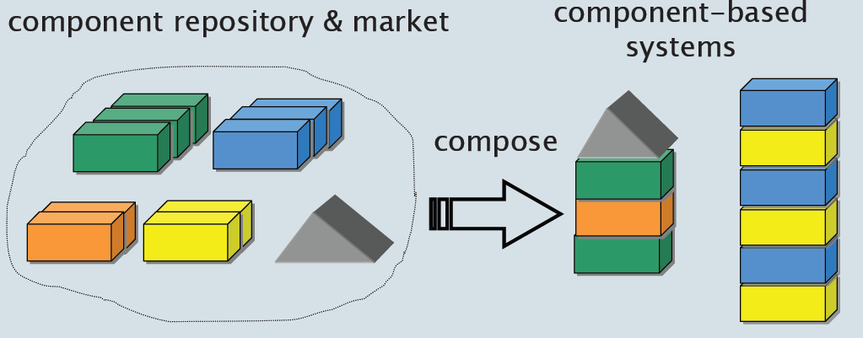
The CBD/CBSE is the Solution…
Systems should be assembled from existing components

Slide 32
Component-based Software Engineering

Slide 33
Component-based Software Engineering
Advantages
Reduce the amount of software to be developed
Reducing cost and risk
Faster delivery of software
Disadvantages
Requirement changes—may lead to a system that does not meet the real needs of users
Control over the system evolution is lost

Slide 34
Process Iteration
Two (related) process models
Incremental delivery
Spiral development

Slide 35
Incremental Model
Advantages:
Customer value can be delivered with each increment so system functionality is available earlier.
Early increments act as a prototype to help elicit requirements for later increments.
Lower risk of overall project failure.
The highest priority system services tend to receive the most testing.
Disadvantages:
Can be difficult to map the customer’s requirements onto increments of the right size.
Hard to identify common functions.

Slide 36
Spiral Model
The software process is represented as spiral, rather than a sequence of activities with some backtracking from one activity to another.
Each loop in spiral represents a phase of the software process
Innermost loop might be concerned with system feasibility
Next loop with requirements definition…next with system designed and so on.

Slide 37
Spiral Model of the Software Process

Slide 38
Spiral Model(Example)
The evolution of Microsoft Operating System, Compilers and other operating systems.

